Slide 1

Scale robust community prediction with node embedding based negative sampling
AI506: DATA MINING AND SEARCH (SPRING 2020)
신동혁, 최현준, 이현지

Slide 2
Interpretation of datasets
Problem Scenario
Base dataset(=paper author.txt) has community information, not only link information.
Test dataset(=query public, query private) also has community information.
Base dataset only provides “positive communities” which we have confidence that they exist.
Assumptions
Base dataset graph is already formed.
Community will be formed based on similar nodes.
Community is complete graph
Base and test dataset graphs are unweighted graphs
Classification vs. Clustering in Community Prediction
Classification accuracy >> Clustering accuracy
→ COMMUNITY PREDICTION task using Classification

Slide 3
Total Flow
Step 1.
Construct Network graph
Step 2.
Sampling Negative Community
Step 3.
Data encoding & Training Classifier
Negative Communities
2362 30008
39072 54714
...
29068 9855 32756 55586 36631
…
A
B
2
1
…
3
Positive Communities
4512 6350 32031
12354 25979 28348 33994 40349 47410
…
…

Slide 4
Step 1. Construct Network graph
Input
Split the communities
Output
paper_author_links
4512 6350
4512 32031
6350 32031
12354 25979
12354 28348
12354 33994
…
40349 47410
…
paper_author.txt
…
4512 6350 32031
12354 25979 28348 33994 40349 47410
…
…
Base dataset which contain (positive) communities
If community consists of more than 3 nodes(=authors),
Split into links which are combination of nodes
Network Graph

Slide 5
Total Flow
Step 1.
Construct Network graph
Step 2.
Sampling Negative Community
Step 3.
Data encoding & Training Classifier
Negative Communities
2362 30008
39072 54714
...
29068 9855 32756 55586 36631
…
A
B
2
1
…
3
Positive Communities
4512 6350 32031
12354 25979 28348 33994 40349 47410
…
…

Slide 6



Step 2. Sampling Negative Community
Input
node2vec
Negative Sampling
Output
(ex) sample community of size 4
Negative Community Samples
2362 30008
39072 54714
…
29068 9855 32756 55586 36631
…
For link(=community of 2),
Just pick one from directed graph
For community of more than 3,
Make a directed graph with lowest similarity of each node connected
Pick the bidirectional pairs from the graph
Draw a community based on the pairs
Find each node’s embedding vector by using node2vec method
Network Graph
Negative Community Samples

Slide 7
Total Flow
Step 1.
Construct Network graph
Step 2.
Sampling Negative Community
Step 3.
Data encoding & Training Classifier
Negative Communities
2362 30008
39072 54714
...
29068 9855 32756 55586 36631
…
A
B
2
1
…
3
Positive Communities
4512 6350 32031
12354 25979 28348 33994 40349 47410
…
…

Slide 8

Step 3. Data encoding & Training Classifier
Extract
subgraphs
Subgraph
labeling
Data encoding
Input
Classification
Positive Communities
4512 6350 32031
12354 25979 28348 33994 40349 47410
…
…
0 | 0 | 1 | 1 | 1 | 0 | 0 | 1 | 0 | 1 | 0 | 0
 | 0 | 1 | 0 | 1 | 1 | 0 | 1 | 0 | 0 | 1 | 1
 |  | 0 | 0 | 1 | 1 | 1 | 0 | 1 | 0 | 0 | 0
 |  |  |  | 0 | 1 | 0 | 1 | 0 | 1 | 0 | 0
Output
A
B
1
2
0
1
Negative Communities
2362 30008
39072 54714
...
29068 9855 32756 55586 36631
…
…
3
Network graph
Training communities:
Positive communities
(paper author)
Negative communities
(output from prev set)
Extract enclosing subgraph for a target communities
Impose a vertex ordering based embedding vector
Construct adjacency matrix using the calculated vertex ordering
Train the classifier
If $GM\left(d\left(A,1\right), d\left(A,2\right),d\left(A,3\right)\right)≥GM\left(d\left(B,1\right), d\left(B,2\right),d\left(B,3\right)\right)$,
Assign $order A≥order B$
Notes:
test dataset 설명 - 같은 방식으로 진행했다!

Slide 9
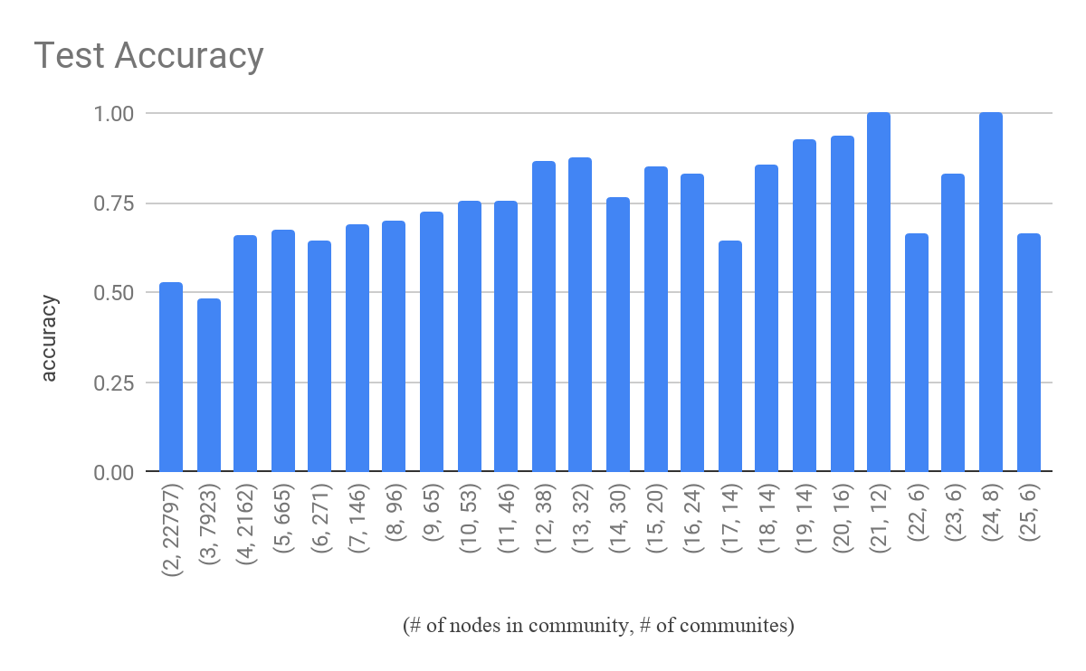
Results
TP | 10939
FP | 9605
TN | 7370
FN | 6086
Precision | 0.53247
Recall | 0.59747
F1 score | 0.56310
Accuracy | 0.5385
Notes:
F1, TP, FP, TN, FN, accuracy
we compared with other models using differents datasets?

Slide 10
Contribution
Our team propose new method that …
Do negative sampling based on node embedding to perform classification task
Is robust to diverse scales of community
Use graph labeling which preserve features of community structure by node embedding
Is extensible to other classification models (GNN, MLP etc)
Notes:
because we make a new dataset by negative sampling and make the task to classification, we do not need to define the number of clusters
Negative Sampling을 했고, random하게 하지 않았다. ⇒ node2vec
community enclosing subgraph labeling을 했는데, 이걸 앞에서 만든 node2vec을 이용했다.

Slide 11
Thanks ☺
AI506: DATA MINING AND SEARCH (SPRING 2020)
신동혁: tlsehdgur0@kaist.ac.kr
최현준: juneir@kaist.ac.kr
이현지: alee6868@kaist.ac.kr

